Slide 1
WCF Fundamentals

Slide 2
What is a Service
In general, a service refers to work that is performed by one or more people that benefits others.
e.g. A doctor performs the service of diagnosis and treatment
In reference to computer software, a service is software that performs automated tasks, responds to hardware events, or listens for data requests from other software. In a user's operating system, these services are often loaded automatically at startup, and run in the background, without user interaction.
e.g. For example, in Microsoft Windows, many services are loaded to accomplish different functions. They respond to user keyboard shortcuts, index and optimize the file system, and communicate with other devices on the local network.
To see the list of services in windows, open cmd and enter: sc query type= service

Slide 3
What is WCF
Windows Communication Foundation (WCF) is a framework for building service-oriented applications. Using WCF, you can send data as asynchronous messages from one service endpoint to another. A service endpoint can be part of a continuously available service hosted by IIS, or it can be a service hosted in an application. An endpoint can be a client of a service that requests data from a service endpoint. The messages can be as simple as a single character or word sent as XML, or as complex as a stream of binary data. A few sample scenarios include:
A secure service to process business transactions.
A service that supplies current data to others, such as a traffic report or other monitoring service.
A chat service that allows two people to communicate or exchange data in real time.
In general, A web application running on one machine and a web service that this application is consuming is running on another machine.
E.g. An ecommerce site using a payment gateway like Paypal
While creating such applications was possible prior to the existence of WCF, WCF makes the development of endpoints easier than ever. In summary, WCF is designed to offer a manageable approach to creating Web services and Web service clients.

Slide 4
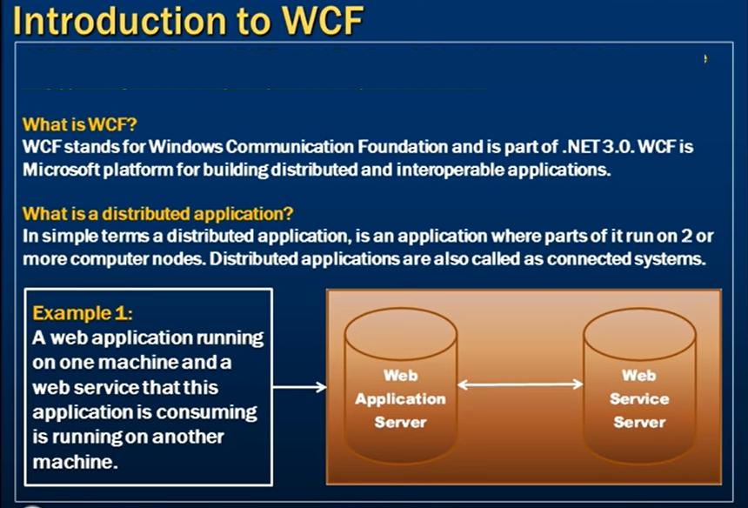

Slide 5
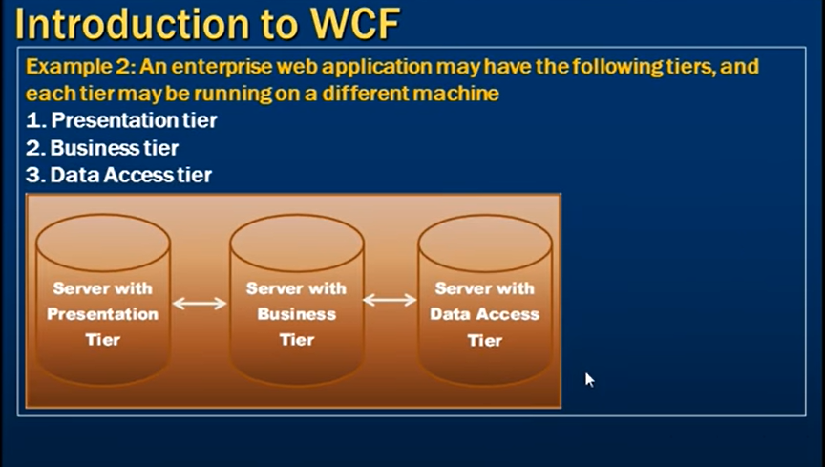

Slide 6
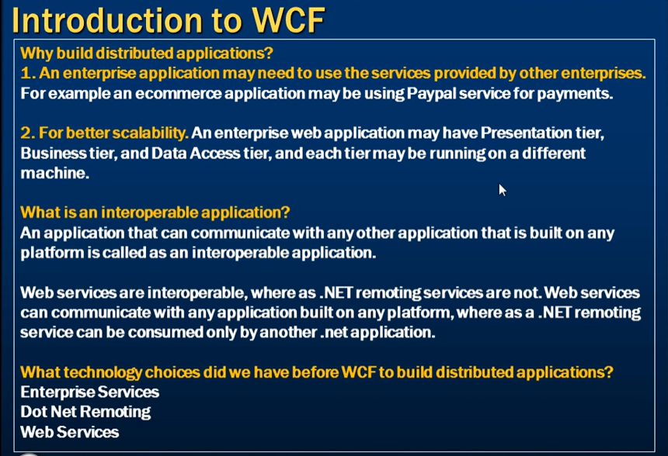

Slide 7
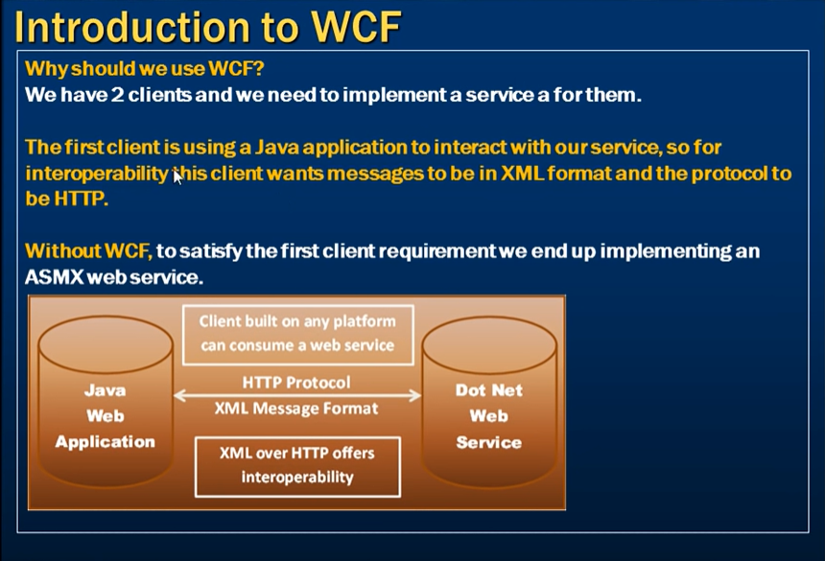
Notes:
ASMX = Active Server Methodss

Slide 8
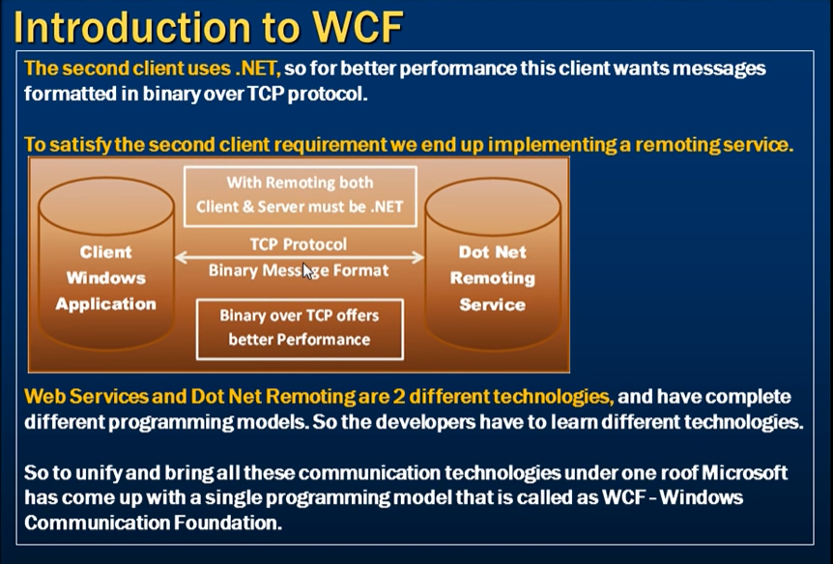

Slide 9
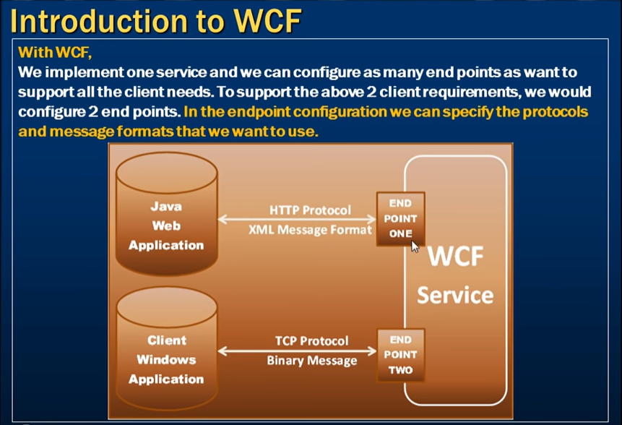

Slide 10
Features of WCF
Service Orientation
WCF enables you to create service oriented applications. Service-oriented architecture (SOA) is the reliance on Web services to send and receive data. The services have the general advantage of being loosely-coupled instead of hard-coded from one application to another. A loosely-coupled relationship implies that any client created on any platform can connect to any service as long as the essential contracts are met.
Interoperability
WCF implements modern industry standards for Web service interoperability.
Multiple Message Patterns
Messages are exchanged in one of several patterns. The most common pattern is the request/reply pattern, where one endpoint requests data from a second endpoint. The second endpoint replies. There are other patterns such as a one-way message in which a single endpoint sends a message without any expectation of a reply. A more complex pattern is the duplex exchange pattern where two endpoints establish a connection and send data back and forth, similar to an instant messaging program.
Service Metadata
WCF supports publishing service metadata using formats specified in industry standards such as WSDL, XML Schema and WS-Policy. This metadata can be used to automatically generate and configure clients for accessing WCF services. Metadata can be published over HTTP and HTTPS or using the Web Service Metadata Exchange standard.
Data Contracts
Because WCF is built using the .NET Framework, it also includes code-friendly methods of supplying the contracts you want to enforce. One of the universal types of contracts is the data contract. In essence, as you code your service using Visual C# or Visual Basic, the easiest way to handle data is by creating classes that represent a data entity with properties that belong to the data entity. WCF includes a comprehensive system for working with data in this easy manner. Once you have created the classes that represent data, your service automatically generates the metadata that allows clients to comply with the data types you have designed.
Security
Messages can be encrypted to protect privacy and you can require users to authenticate themselves before being allowed to receive messages. Security can be implemented using well-known standards such as SSL or WS-SecureConversation.

Slide 11
Features of WCF – Cont.d
Multiple Transports and Encodings
Messages can be sent on any of several built-in transport protocols and encodings. The most common protocol and encoding is to send text encoded SOAP messages using the HyperText Transfer Protocol (HTTP) for use on the World Wide Web. Alternatively, WCF allows you to send messages over TCP, named pipes, or MSMQ. These messages can be encoded as text or using an optimized binary format. Binary data can be sent efficiently using the MTOM standard. If none of the provided transports or encodings suit your needs you can create your own custom transport or encoding.
Reliable and Queued Messages
WCF supports reliable message exchange using reliable sessions implemented over WS-Reliable Messaging and using MSMQ.
Durable Messages
A durable message is one that is never lost due to a disruption in the communication. The messages in a durable message pattern are always saved to a database. If a disruption occurs, the database allows you to resume the message exchange when the connection is restored. You can also create a durable message using the Windows Workflow Foundation (WF).
Transactions
WCF also supports transactions using one of three transaction models: WS-AtomicTransactions, the APIs in the System.Transactions namespace, and Microsoft Distributed Transaction Coordinator.
AJAX and REST Support
REST is an example of an evolving Web 2.0 technology. WCF can be configured to process "plain" XML data that is not wrapped in a SOAP envelope. WCF can also be extended to support specific XML formats, such as ATOM (a popular RSS standard), and even non-XML formats, such as JavaScript Object Notation (JSON).
Extensibility
The WCF architecture has a number of extensibility points. If extra capability is required, there are a number of entry points that allow you to customize the behavior of a service.

Slide 12
Fundamental Windows Communication Foundation Concepts
Messaging
WCF is based on the notion of message-based communication, and anything that can be modeled as a message (for example, an HTTP request or a Message Queuing (also known as MSMQ) message) can be represented in a uniform way in the programming model. This enables a unified API across different transport mechanisms.
The model distinguishes between clients, which are applications that initiate communication, and services, which are applications that wait for clients to communicate with them and respond to that communication. A single application can act as both a client and a service.
Endpoints
Messages are sent between endpoints. Endpoints are places where messages are sent or received (or both), and they define all the information required for the message exchange. A service exposes one or more application endpoints (as well as zero or more infrastructure endpoints), and the client generates an endpoint that is compatible with one of the service's endpoints.
An endpoint describes in a standard-based way where messages should be sent, how they should be sent, and what the messages should look like. A service can expose this information as metadata that clients can process to generate appropriate WCF clients and communication stacks.

Slide 13
Fundamental Windows Communication Foundation Concepts – Cont.d
Communication Protocols
One required element of the communication stack is the transport protocol. Messages can be sent over intranets and the Internet using common transports, such as HTTP and TCP. More transport mechanisms can be added using the built-in extension points of WCF.
Message Patterns
WCF supports several messaging patterns, including request-reply, one-way, and duplex communication. Different transports support different messaging patterns, and thus affect the types of interactions that they support. The WCF APIs and runtime also help you to send messages securely and reliably.

Slide 14
WCF Terms
Other concepts and terms used in the WCF documentation include the following:
Message A self-contained unit of data that can consist of several parts, including a body and headers.
Service A construct that exposes one or more endpoints, with each endpoint exposing one or more service operations.
Endpoint A construct at which messages are sent or received (or both). It comprises a location (an address) that defines where messages can be sent, a specification of the communication mechanism (a binding) that describes how messages should be sent, and a definition for a set of messages that can be sent or received (or both) at that location (a service contract) that describes what message can be sent. A WCF service is exposed to the world as a collection of endpoints.

Slide 15
Address Specifies the location where messages are received. It is specified as a Uniform Resource Identifier (URI). The URI schema part names the transport mechanism to use to reach the address, such as HTTP and TCP. The hierarchical part of the URI contains a unique location whose format is dependent on the transport mechanism.
The endpoint address enables you to create unique endpoint addresses for each endpoint in a service or, under certain conditions, to share an address across endpoints.
Binding Defines how an endpoint communicates to the world. It is constructed of a set of components called binding elements that "stack“
one on top of the other to create the communication infrastructure. At the very least, a binding defines the transport (such as HTTP or TCP)
and the encoding being used (such as text or binary). A binding can contain binding elements that specify details like the security mechanisms
used to secure messages, or the message pattern used by an endpoint.

Slide 16
Service operation A procedure defined in a service's code that implements the functionality for an operation. This operation is exposed to clients as methods on a WCF client. The method can return a value, and can take an optional number of arguments, or take no arguments, and return no response. For example, an operation that functions as a simple "Hello" can be used as a notification of a client's presence and to begin a series of operations.
Service contract Ties together multiple related operations into a single functional unit. The contract can define service-level settings, such as the namespace of the service, a corresponding callback contract, and other such settings. In most cases, the contract is defined by creating an interface in the programming language of your choice and applying the ServiceContractAttribute attribute to the interface. The actual service code results by implementing the interface.
Operation contract An operation contract defines the parameters and return type of an operation. When creating an interface that defines the service contract, you signify an operation contract by applying the OperationContractAttribute attribute to each method definition that is part of the contract. The operations can be modeled as taking a single message and returning a single message, or as taking a set of types and returning a type. In the latter case, the system will determine the format for the messages that need to be exchanged for that operation.

Slide 17
Data contract The descriptions in metadata of the data types that a service uses. This enables others to interoperate with the service. The data types can be used in any part of a message, for example, as parameters or return types. If the service is using only simple types, there is no need to explicitly use data contracts.
Message contract Describes the format of a message. For example, it declares whether message elements should go in headers versus the body, what level of security should be applied to what elements of the message, and so on.
Fault contract Can be associated with a service operation to denote errors that can be returned to the caller. An operation can have zero or more faults associated with it. These errors are SOAP faults that are modeled as exceptions in the programming model.

Slide 18
Behaviors A component that controls various run-time aspects of a service, an endpoint, a particular operation, or a client. Behaviors are grouped according to scope: common behaviors affect all endpoints globally, service behaviors affect only service-related aspects, endpoint behaviors affect only endpoint-related properties, and operation-level behaviors affect particular operations.
For example, one service behavior is throttling, which specifies how a service reacts when an excess of messages threaten to overwhelm its handling capabilities.
An endpoint behavior, on the other hand, controls only aspects that are relevant to endpoints, such as how and where to find a security credential.
Binding element Represents a particular piece of the binding, such as a transport, an encoding,
an implementation of an infrastructure-level protocol (such as WS-ReliableMessaging), or any other component of the communication stack.
System-provided bindings WCF includes a number of system-provided bindings. These are collections of binding elements that are optimized for specific scenarios.
For example, the WSHttpBinding is designed for interoperability with services that implement various WS-* specifications. These predefined bindings save time by presenting only those options that can be correctly applied to the specific scenario.
If a predefined binding does not meet your requirements, you can create your own custom binding.

Slide 19
Hosting A service must be hosted in some process. A host is an application that controls the lifetime of the service. Services can be self-hosted or managed by an existing hosting process.
Self-hosted service A service that runs within a process application that the developer created. The developer controls its lifetime, sets the properties of the service, opens the service (which sets it into a listening mode), and closes the service.
Hosting process An application that is designed to host services. These include Internet Information Services (IIS), Windows Activation Services (WAS), and Windows Services. In these hosted scenarios, the host controls the lifetime of the service. For example, using IIS you can set up a virtual directory that contains the service assembly and configuration file. When a message is received, IIS starts the service and controls its lifetime.

Slide 20
Client application A program that exchanges messages with one or more endpoints. The client application begins by creating an instance of a WCF client and calling methods of the WCF client. It is important to note that a single application can be both a client and a service.
WCF client A client-application construct that exposes the service operations as methods (in the .NET Framework programming language of your choice, such as Visual Basic or Visual C#). Any application can host a WCF client, including an application that hosts a service. Therefore, it is possible to create a service that includes WCF clients of other services.
Metadata In a service, it describes the characteristics of the service that an external entity needs to understand to communicate with the service. When enabled, metadata for the service is automatically generated by WCF by inspecting the service and its endpoints. To publish metadata from a service, you must explicitly enable the metadata behavior.
Security In WCF, includes confidentiality (encryption of messages to prevent eavesdropping), integrity (the means for detection of tampering with the message), authentication (the means for validation of servers and clients), and authorization (the control of access to resources).

Slide 21
Service End Point
An End point consists of three things, which are A,B,C
Address (Where?)
Binding (how?)
Contract (What?)
Endpoint = A + B+ C

Slide 22
Address
Address is the address of WCF Service, where the Service is hosted? It gives the exact URL of Web Service, where the Service hosts the pattern of URL, which is- Scheme://domain/[:port]/path net.tcp://localhost:1234/MyService http://localhost:1234/MyService Binding
It describes the way or mechanism by which the user will communicate with Web Service. It constitutes some binding element, which creates the structure of communication such as some transport protocols like HTTP, TCP etc. Message format or security techniques etc. Contract
What functionality and operation is being provided by the service is called contract. It specifies what functionality and operations are need to be exposed to the client. It is the interface name which has all operation that need to be exposed. SOAP SOAP stands for Simple Object Access Protocol. It is not a transport protocol but an XML based message protocol.

Slide 23
WCF service
User Defined Pass
Inbuilt Type
How to convert to RESTful.

